Slide 1
terorist takedown Terrorist attack preventing system
Members:
Nemanja Antić
FIlip Lazić

Slide 2
H2020
Project type: STREP
Project length: 1 year
Short description:
Terrorist takedown is information system which with use of drones take picture of peoples on events and proccessing pictures, with use of artificial inteligence and machine learning algorithms, and anylizing if there is suspicious people.

Slide 3
TERRORIST ATTACKS
ATTENTION!!!
FOLLOWING PICTURES CONTAIN DISTURBING CONTENTS

Slide 4
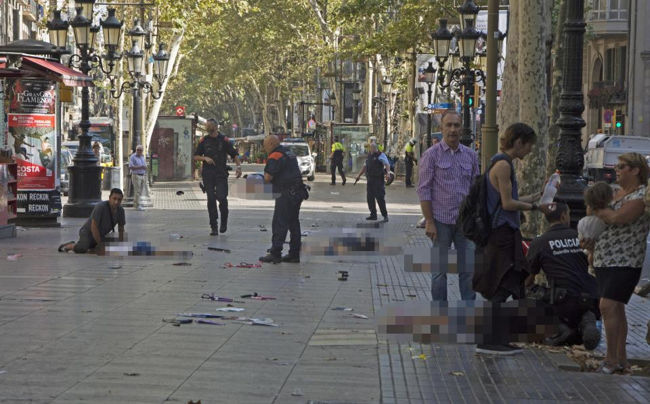
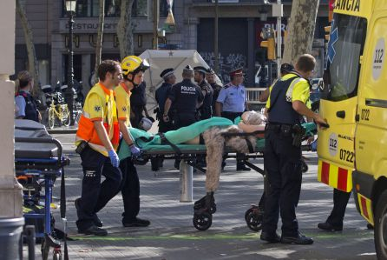
Spain terror attacks: 13 killed and 100 injured
(theguardian news)

Slide 5
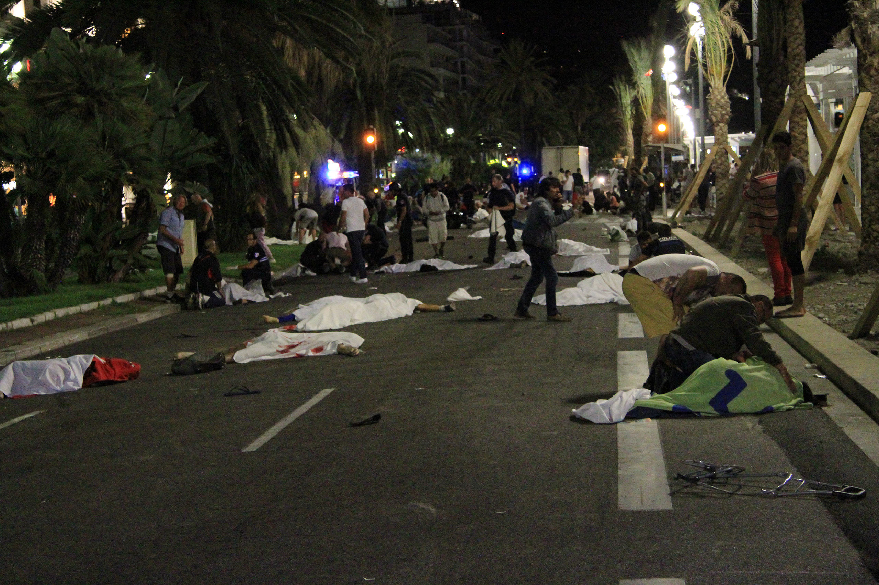
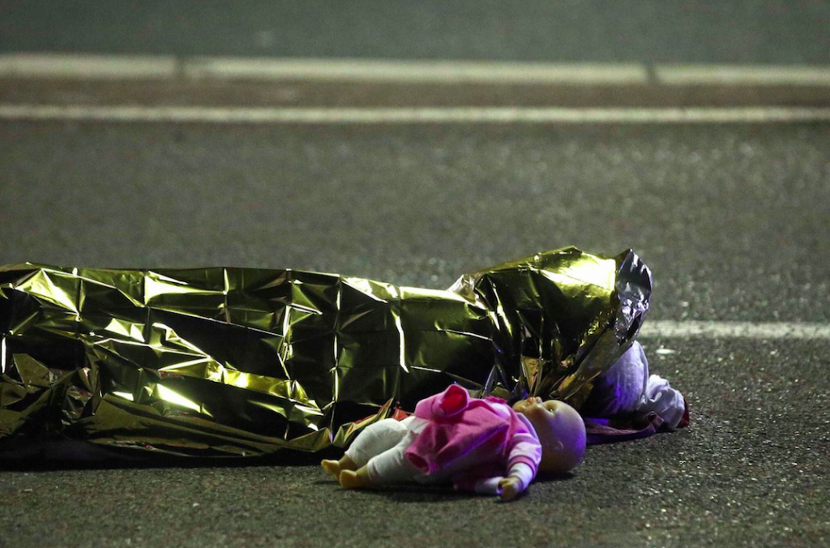
BAstille day in nice, 86 dead, 434 injured (wikipedia)

Slide 6
ANY SOLUTION? ANy idea?
Terrorist takedown maybe?
Terrorist takedown will have great impact on world security and he will helped to deal with threat once for all.

Slide 7
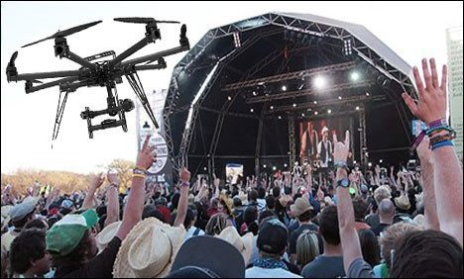
Functionality
Drones will be remotely navigated by system , taking pictures of faces and sending they to system
System will have sophisticated algorithms to compare pictures and many other operations

Slide 8
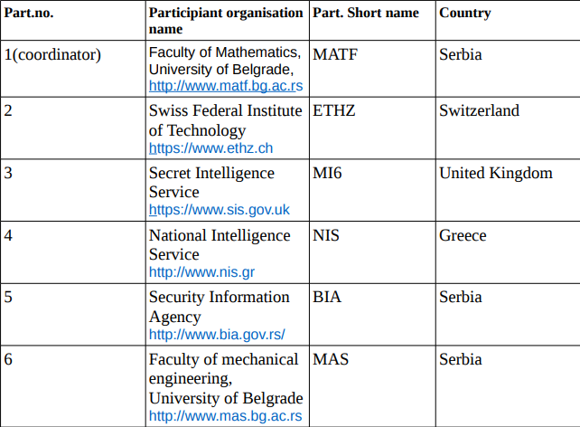
PARTICIPANTs

Slide 9
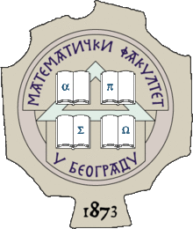
University of Belgrade, Faculty of Mathematics, MATF
Faculty of mathematics have more than 6000 graduate mathematicians, 400 doctors of mathematics and computer sciences, 700 Magisters of Science and many specialists. Numerous graduates occupy various positions in research institutions, government offices, companies and schools in the country and abroad. Department for Informatics and Computer Science have big impact on development of Computer Science in Serbia.

Slide 10

University of Belgrade, Faculty of mechanical engineering, MAS
MAS perform basic, applied, development and scientific research to improve education and scientific research in the areas of production engineering and application computers, machinery (transport, construction and mining machinery), agricultural mechanical engineering, motor vehicles and trailers (transport, labor and special) effectiveness of mechanical systems, thermodynamics, thermal power, hydropower, railway engineering, shipbuilding, aviation, military mechanical engineering, weapons systems, and cosmic technology. Organizing scientific conferences and seminars, cooperation with educational, scientific and other organizations at home and abroad.

Slide 11

ETH Zurich
At ETH Zurich, students discover an ideal environment for independent thinking, researchers a climate which inspires top performance. Situated in the heart of Europe, yet forging connections all over the world, ETH Zurich is pioneering effective solutions to the global challenges of today and tomorrow. ETH Zurich is one of the Europe leader in development of Machine Learning and Artificial Intelligence.

Slide 12

Security information agency Serbia, BIA
The Security-Information Agency (BIA) is established on the bases of the Law on the Security-Information Agency which came into effect on July 27, 2002, as a special organization of the Government of the Republic of Serbia, with legal entity status. BIA is a civil, national security service and a part of a unique securityintelligence system of the Republic of Serbia. It functions on the bases and within the framework of the Constitution, laws, other regulations and general acts, national security strategy, defense strategy and defined security-intelligence policy of the Republic of Serbia. Competences of the Security-Information Agency are : -protection of the security of the Republic of Serbia; -research, gathering, processing and assessment of security- intelligence data and findings significant for the security of the Republic of Serbia, as well as informing the relevant state authorities on the said data...

Slide 13

Secret intelligence service UK, MI6
The Secret Intelligence Service (SIS), commonly known as MI6, is the foreign intelligence service of the government of the United Kingdom, tasked mainly with the covert overseas collection and analysis of human intelligence (HUMINT) in support of the UK's national security. SIS is a member of the country's intelligence community and its Chief is accountable to the country's Foreign Secretary. The stated priority roles of SIS are counter-terrorism, counter-proliferation, providing intelligence in support of cyber security, and supporting stability overseas to disrupt terrorism and other criminal activities.

Slide 14

National Intelligence Service Greece, NIS
The National Intelligence Service (NIS) is the national intelligence agency of Greece. Originally modeled after the United States Central Intelligence Agency, it was established in 1953 as the Central Intelligence Service (CIS), specializing in intelligence gathering, counterintelligence activities and securing sensitive state communications. As Greece's primary intelligence agency, NIS is responsible for a range of domestic and foreign matters, ranging from criminal activities and civil rights violations, to terrorism and espionage.

Slide 15
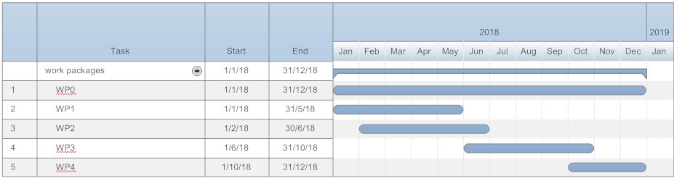
PROJECT SCHEDULE GANTT CHART
The project is organized in 5 work packages:
WP0 Project management
WP1 Making drones
WP2 Designing an algorithm
WP3 Implementation
WP4 Testing in real-life scenario

Slide 16
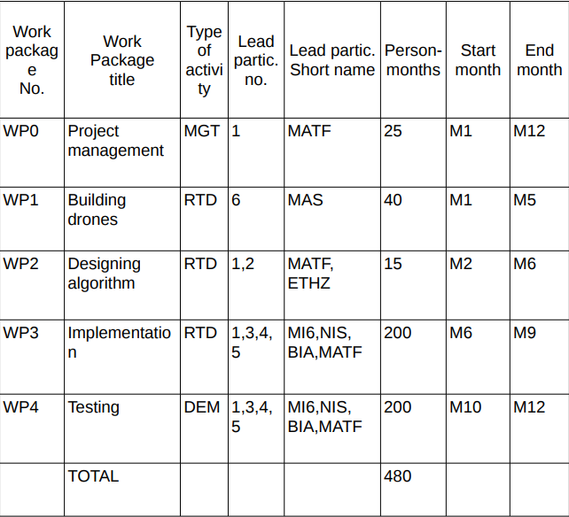
WORK PACKAGE LIST

Slide 17
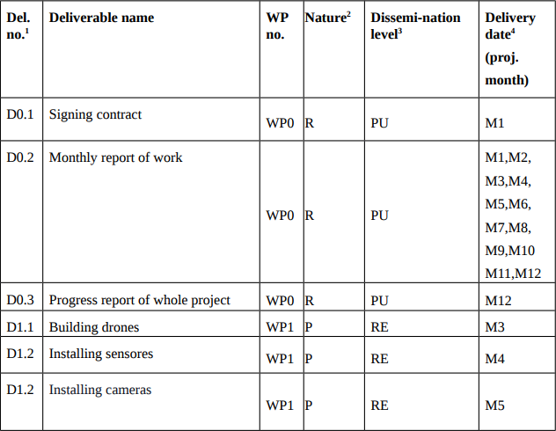
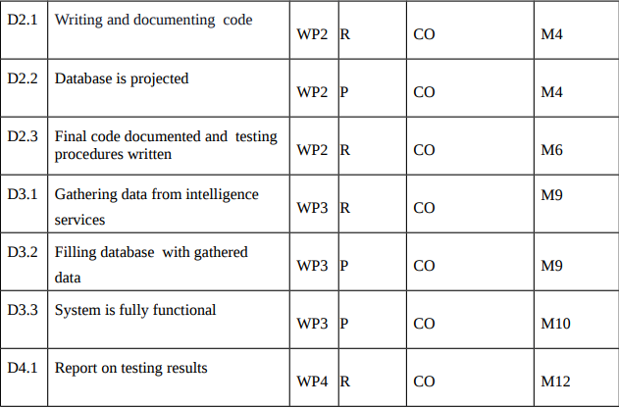
LIST of Deliverables

Slide 18
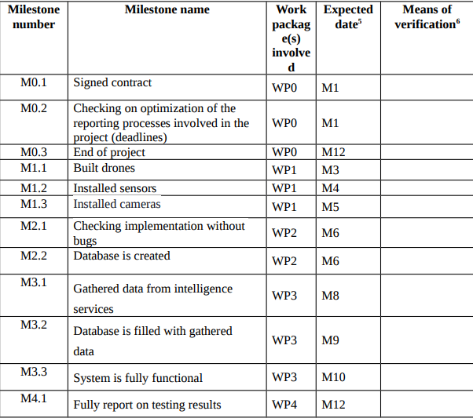
MILESTONES

Slide 19
WHEN THE PROJECT IS OVER
In agreement with the government project will participate in business forums
All countries will be able to purcharge this system and cutdown risk of terrorist attacks
System will be more powerful with his expansion in many countries

Slide 20
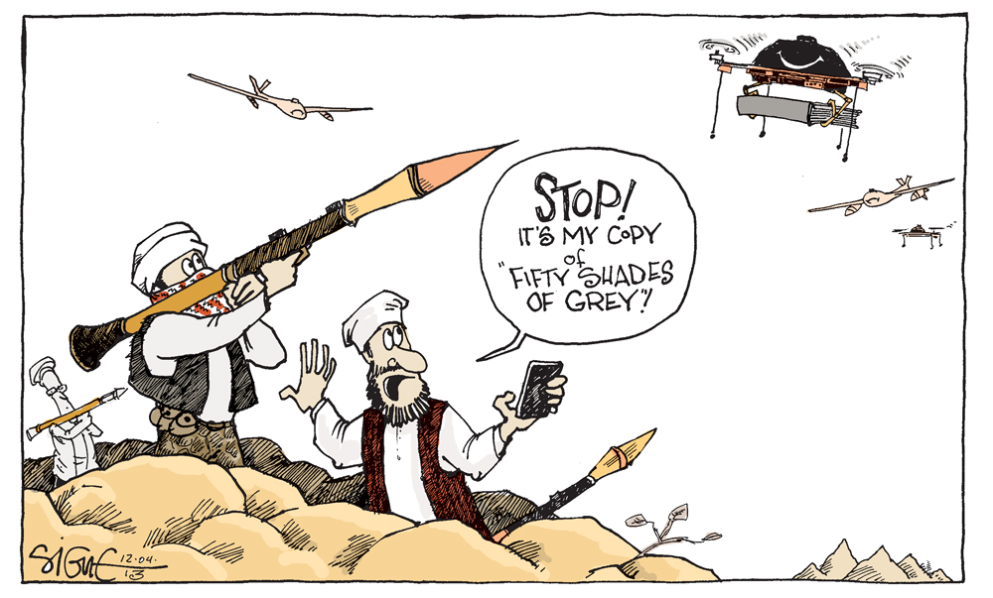
THank you for your attention!

